Slide 1


Language
[Instructor Name]
[Class Section Number]
Notes:
Language and Language Use can be taught in one long class period. If you have a course set up with a long and a short class period it is optimal to lecture during the long period and use the shorter time for a class activity.
Technical Note: These slides may contain simple click animation so that you can focus students’ attention on a particular question, a selection of text, or an image and not have them be distracted by reading ahead. You can either preview the sequence of animation by going through the slides in slideshow view, visiting the animations tab, or reviewing the slide notes. In the notes you will see a cue - (Click) – that corresponds to each animation.
You will also find hyperlinks to outside videos at various places in the slides. These hyperlinks are embedded in text and indicated by color and in the notes section.
Discussion/warm-up: Start by asking students about their own thoughts and experiences regarding learning and using language. Sample questions include:
-- Imagine if humans had no spoken language. How would the world be different? (simple answers might include “there would be no books” or “we would not have conversations”; More sophisticated answers might include imaginative possibilities such as developing complex sign languages, changes in the way people acquire language…. That is, children would have to develop motor coordination and not only verbal readiness.)
-- Do you remember the most recent time you learned a new word or words? How did you acquire this vocabulary? How does knowing this word help you?
When debriefing their answers you can highlight some of the major themes or points of learning from this module.

Slide 2
Overview
Introduction
Use of language
Content of language
Psychology of language use
Notes:
This slide provides an overview of the material that will be covered during the lecture.

Slide 3


Introduction
Notes:
This slide illustrates the importance of language.
Discussion question: How does language set humans apart from other animals?
Explanation: In a way, language and our ability to communicate is what makes us human. Though all primates have the ability to reason and think logically, humans have a wider range of ways to communicate complex, abstract thought.

Slide 4
Overview
Introduction
Use of language
Content of language
Psychology of language use
Notes:
This slide provides an overview of the material that will be covered during the lecture.

Slide 5

Use of Language
Everyone uses language
Many Forms
Important Factors:
Common ground
Audience design
Situation models
Priming
Notes:
This slide illustrates the use of language throughout the life span and identifies key concepts related to language.
Overview: Every human group has a language; human infants (except those who have unfortunate disabilities) learn at least one language without being taught explicitly. Even when children who don’t have much language to begin with are brought together, they can begin to develop and use their own language.
(Click) Everyone uses language (video)
Video: The 2 minute video embedded in the hyperlink provides an example of two toddler twins communicating with one another.
Discussion: After showing the video, ask students to generate evidence to support the fact that the twins were indeed communicating with one another and not just making sounds.
(Click) Many forms
Explanation: Communication comes in many forms including written, spoken, and body language. The goal of all language is to transmit information from the communicator to the receiver of information for varied purposes such as persuading, informing, bonding, and entertaining.
(Click) Important Factors: Common ground
Explanation: In order to have a conversation people in the conversation must keep track of common ground, which is a set of knowledge that the speaker and listener share and they think, assume, or otherwise take for granted that they share. For example, if the instructor said, “The exam is next week.” Students would understand the subject of the exam (and hopefully the material). It’s important to note that common ground can change as the conversation progresses and as each person gathers new information that is agreed on and has evidence that we share. It evolves as people take turns assuming the roles of speaker and listener, and actively engage in the exchange of meaning.
(Click) Audience design
Explanation: Another closely related concept is audience design. Audience design refers to the tendency for speakers to design their utterances for their audiences by taking into account the audiences’ knowledge. In the instructor example, if the instructor (who teaches multiple classes) was talking to a colleague and mentioned the preparation for an exam, the instructor would likely have to add information (e.g., “I am preparing to give an exam to my Intro to Psych class on Language.”) because the colleague would not have information or exposure to the same information the students have. Another example is how adults talk to children, which is very different from how they would talk to adults.
Audience design is a remarkably complex task, especially in larger groups. However, research has demonstrated that 90% of our conversations are to groups of 4 people or less. Regardless, the fact that we communicate so frequently every day with so many different individuals is amazing considering we have to take into consideration common ground and the audience that will be receiving the information.
(Click) Situation models and Priming
Explanation: Situation models and priming effects are also at play in everyday conversations. Interpersonal alignments at different levels of language use can activate similar situation models of those involved in the conversation. The situation model states that those involved in the conversation begin to use similar words and grammar, and many other aspects of language use converge. This is very similar to priming, a concept that was previous discussed, that occurs when one concept reminds you about other related concepts.

Slide 6
Use of Language
Tab__
Cha__
Des__
Sof__
Table
Chair
Desk
Sofa
Taboo
Chant
Destiny
Soft
Notes:
This slide shares the priming activity.
Instructor’s note: (Detailed for this activity can be found in IM > Cognition, Language, & Intelligence > Module 2: Language and Language Use > Activities Demonstrations)
Activity: Show a slide with the following:
Tab__ Cha__ Des_ Sof_ Ask the student to fill in the missing letters.
(Click) Show group 1 possible answers: Table, Chair, Desk, Sofa.
Discussion: Ask how many students got these answers.
(Click) Show group 2 possible answers: Taboo, Chant, Destiny, Soft.
Discussion: Ask how many students chose these words. Ask why more students chose the first four words than the second.
Explantion: Because of priming. We are primed to fill in the missing words, which is why most people can read a paragraph with the middle letters blacked out. Priming is also in effect where we guess with words that go together. Group 1 is all furniture. Group 2 are four words that could be correct but have no relationship. Priming makes group 1 more probable.

Slide 7
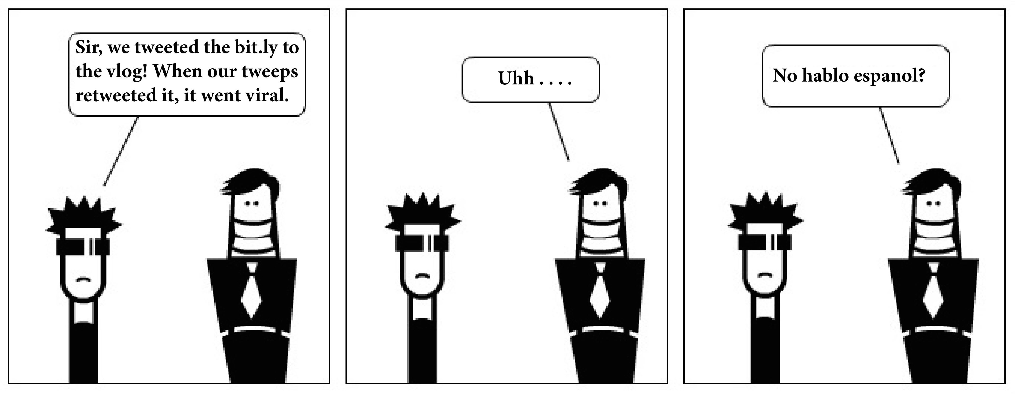
Use of Language
Components:
Lexicon
  Incorrect: “There’s not a snowball’s chance in the arctic.”
Syntax
  Incorrect: “Apple crawled the worm inside.”
Notes:
This slide illustrates the two primary components of language: lexicon and syntax
Instructor’s note: Introduce the components of language using the image on the slide as an example.
(Click) Components: Lexicon: Incorrect: “There’s not a snowball’s chance in the arctic.”
Explanation: Lexicon refers to words and expressions. Below “Lexicon” on the slide is an example of incorrect lexicon. The original idiom, or expression, is “There’s not a snowball’s chance in hell,” which refers to the understanding that hell is hot and would melt a snowball, and means that there’s no chance. Since there are likely many snowballs in the arctic, this expression doesn’t work. Lexicon failures often do not make sense.
(Click) Syntax: Incorrect: “Apple crawled the worm inside.”
Explanation: Syntax refers to grammatically correct and meaningful sentences. Below “Syntax” on the slide is an example of incorrect syntax. The sentence should read “The worm crawled inside the apple.” In English grammar, correct sentences are usually written in this order: subject/verb/object, and the incorrect example is written in this order: object/verb/subject, which makes it difficult to understand.
Discussion question: How is the cartoon on the slide an illustration of both lexicon and syntax?
Explanation: The image on the slide shows an example of correct lexicon and syntax in context of social media jargon. However, even though the lexicon and syntax are correct, the meaning is still misunderstood. The person on the left is fluent in this jargon, but the person on the right isn’t, so he’s confused. This is an instance of one person having words and expressions in their lexicon that the other person doesn’t have, causing an inability to communicate.
In addition to similar lexicon and syntax shared in a conversation, people in a conversation tend to exhibit similar accents and rates of speech.

Slide 8
Overview
Introduction
Use of language
Content of language
Psychology of language use
Notes:
This slide provides an overview of the material that will be covered during the lecture.

Slide 9

Content of Language
Topics of conversation:
Ingroup & Outgroup
Linguistic intergroup bias
Social brain hypothesis
Conveys permanency/stability
Social networks
Notes:
This slide introduces the content of what people talk about in everyday conversations.
Discussion question: What are some common topics of conversation that you find yourself participating in with friends and family? What do you think the most common subject of everyday conversation is?
Explanation: We can communicate about mundane things such as what to have for dinner, but also more complex and abstract things such as the meaning of life and death, liberty, equality, and fraternity, and many other philosophical thoughts. Well, when naturally occurring conversations were actually observed. However, 60%–70% of everyday conversation, for both men and women, turned out to be gossip—people talk about themselves and others whom they know.
(Click) Ingroup & Outgroup
Gossiping has an important function in our relationships. Specifically, gossiping allows humans to share representations about their social world—who their friends and enemies are, what the right thing to do is under what circumstances, and so on. In so doing, they can regulate their social world—making more friends and enlarging one’s own group (often called the ingroup, the group to which one belongs) against other groups (outgroups) that are more likely to be one’s enemies.
(Click) Linguistic intergroup bias
Linguistic intergroup bias is the phenomenon where we tend to talk about positive attributes of the ingroup and negative attributes of the outgroup with adjectives instead of verbs. So ingroup members are viewed as generally and permanently good and outgroup members generally and permanently bad, where the negative attributes of the ingroup and positive attributes of the outgroup would be talked about using verbs – because they are viewed as a one-time occurrence.
(Click) Social brain hypothesis
Dunbar (1996), with his social brain hypothesis, argued that these social effects have given humans an evolutionary advantage and larger brains, which, in turn, help humans to think more complex and abstract thoughts and, more important, maintain larger ingroups. In fact, Dunbar developed an equation that allowed him to predict the group size that human brains can support, which turned out to be about 150 (about the size of modern hunter-gatherer communities).
(Click) Conveys permanency/stability
As humans we use these language techniques to communicate stability and permanency as traits. They help us identify who is part of our ingroup and who is considered an outsider. We can also use language to describe others roles, character, and personality.
(Click) Social networks
Finally, if gossip is transmitted from one person to another, the second person can transmit it to a third person, who then in turn transmits it to a fourth, and so on through a chain of communication called a social network. If gossip is repeatedly transmitted and spread, it can reach a large number of people. When stories travel through communication chains, they tend to become conventionalized. After the retelling of this story, much of the counter-stereotypical information is dropped, and stereotypical information is more likely to be retained. Because stereotypes are part of the common ground shared by the community, this finding too suggests that conversational retellings are likely to reproduce conventional content.

Slide 10
Overview
Introduction
Use of language
Content of language
Psychology of language use
Notes:
This slide provides an overview of the material that will be covered during the lecture.

Slide 11

Psychology of Language Use
Labeling emotions
Healing with language
Improved memory and decision making
Sapir-Whorf hypothesis
Cultural differences
Notes:
This slide describes the important psychological effects of using language.
Discussion question: How do you think language affects our psychology and vice versa?
(Click) Labeling emotions
Explanation: A linguistic representation of another person’s emotion biases the speaker’s memory of that person’s emotion. Furthermore, linguistically labeling one’s own emotional experience appears to alter the speaker’s neural processes. When people linguistically label negative images, the amygdala — a brain structure that is critically involved in the processing of negative emotions such as fear — is activated less than when they were not given a chance to label them.
(Click) Healing with language
Discussion question: How might language help people be psychologically healthier?
Explanation: Language has the potential to help people overcome negative life experiences and even trauma. Potentially because of these effects of verbalizing emotional experiences, linguistic reconstructions of negative life events can have some therapeutic effects on those who suffer from the traumatic experiences. Other studies have found that writing and talking about negative past life events improved people’s psychological well-being, but just thinking about them worsened it. (Image is of a poetry reading, along with songs about traumatic experiences, i.e. lost love, poetry may serve as a good example for students of therapeutic potential of language)
(Click) Improved memory and decision making
Explanation: In addition to improving psychological well-being, better memory and decision making also occur with the use of language. Thus it may be more human nature and less dependent to seek out others’ opinions when faced with big decisions because verbalizing may be advantageous.
(Click) Sapir-Whorf hypothesis
The Sapir-Whorf hypothesis states that the language one uses can influence their cognition. In its strong form, it has been argued that language determines thought, but this is probably wrong. Language does not completely determine our thoughts—our thoughts are far too flexible for that—but habitual uses of language can influence our habit of thought and action.
(Click) Cultural differences
Explanation: The way a given culture uses language is also reflective of the Sapir-Whorf hypothesis. Pronoun drop is the case in point. Pronouns such as “I” and “you” are used to represent the speaker and listener of a speech in English. In an English sentence, these pronouns cannot be dropped if they are used as the subject of a sentence. So, for instance, “I went to the movie last night” is fine, but “Went to the movie last night” is not standard in English. However, in other languages such as Japanese, pronouns can be, and in fact often are, dropped from sentences. It turned out that people living in those countries where pronoun drop languages are spoken tend to have more collectivistic values (e.g., employees having greater loyalty toward their employers) than those who use non–pronoun drop languages such as English.

Slide 12
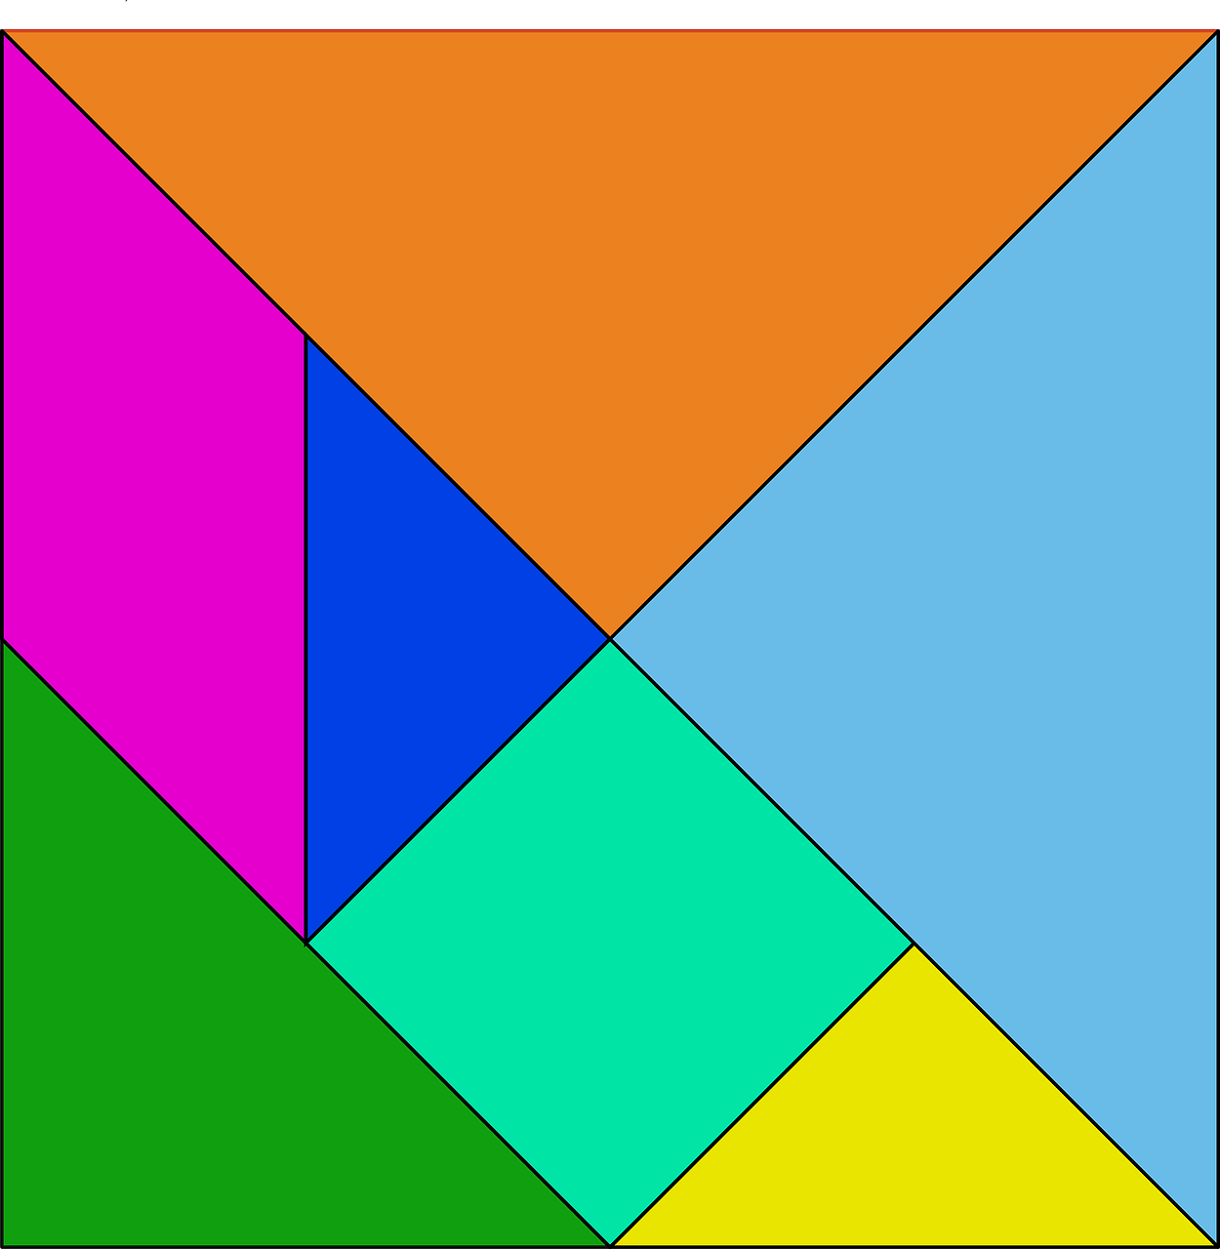
Activity
Rules
No using English during Time-In
No looking after the phoneme combinations are understood
Notes:
This slide presents an activity that demonstrates the complexity of communicating through language. The purpose of this activity is to think about how language develops and how communication can take place with the most basic language as long as there is commonality among the participants in the conversation.
Instructor’s note: (For details of this activity see IM > Cognition, Language, & Intelligence > Module 2: Language and Language Use > Activities Demonstrations) Refer to this website for more detailed information about this activity: http://www.devpsy.org/teaching/language/language_game.html
Activity:
Start with having a volunteer come up with a note pad and pen (or provide one).
Have her face the class then put up this slide.
You, or a second student volunteer, should describe the image. The student sitting (facing so he can’t see the image) draws it based on the descriptions.
Discussion: Talk about the difficulty. Then tell students they are going to do the same thing, only they can’t use English!
(Click) Rules
Break the class into groups of 4-6.
Give each group a set of phonetic symbols and a set of image tiles. You can print and cut out the image from this slide.
The task is to come up with a language using the phonemes where one group member can direct a second to recreate a shape through language only. You may need to help get a group started by pointing to a shape and naming it – the group will likely use your word, then start creating their own.
Discussion: The link gives a few time-out, time-in mini discussions that can happen throughout the activity.
At the end of the activity, ask for a couple of groups to volunteer. Create a new arrangement of the tiles and have one member tell the other what to do.

Slide 13
Photo Attribution
Slide 1 | Photo Credit: TobiasMik · WhatWeDo https://www.flickr.com/photos/21358963@N06/3809460658/ https://creativecommons.org/licenses/by-nc-sa/2.0/
Slide 3 | Photo Credit: ucumari https://www.flickr.com/photos/18922711@N00/482741260/ https://creativecommons.org/licenses/by-nc-nd/2.0/
Slide 3 | Photo Credit: Billy Wilson Photography https://www.flickr.com/photos/32132568@N06/4770079940/ https://creativecommons.org/licenses/by-nc/2.0/
Slide 5 | Photo Credit: Marc Wathieu https://www.flickr.com/photos/88133570@N00/2945003307/ https://creativecommons.org/licenses/by-nc/2.0/
Slide 7 | Photo Credit: seanrnicholson https://www.flickr.com/photos/53618990@N03/6448946161/ https://creativecommons.org/licenses/by-nd/2.0/
Slide 9 | Photo Credit: Martin Hricko https://www.flickr.com/photos/81940846@N05/8204038502/ https://creativecommons.org/licenses/by/2.0/
Slide 11 | Photo Credit: kavitakapoor https://www.flickr.com/photos/52872272@N00/7065447149/ https://creativecommons.org/licenses/by-nc-sa/2.0/
Slide 12 | Photo Credit: Nemo. http://pixabay.com/en/shapes-shape-colored-color-28923/ http://creativecommons.org/publicdomain/zero/1.0/deed.en

